Slide 1

Data Shared Across Organizations Or Cloud Platforms Is Vulnerable To Interception And Misuse.
DATA SECURITY:
Presented by:
Sravani group
Notes:
1

Slide 2
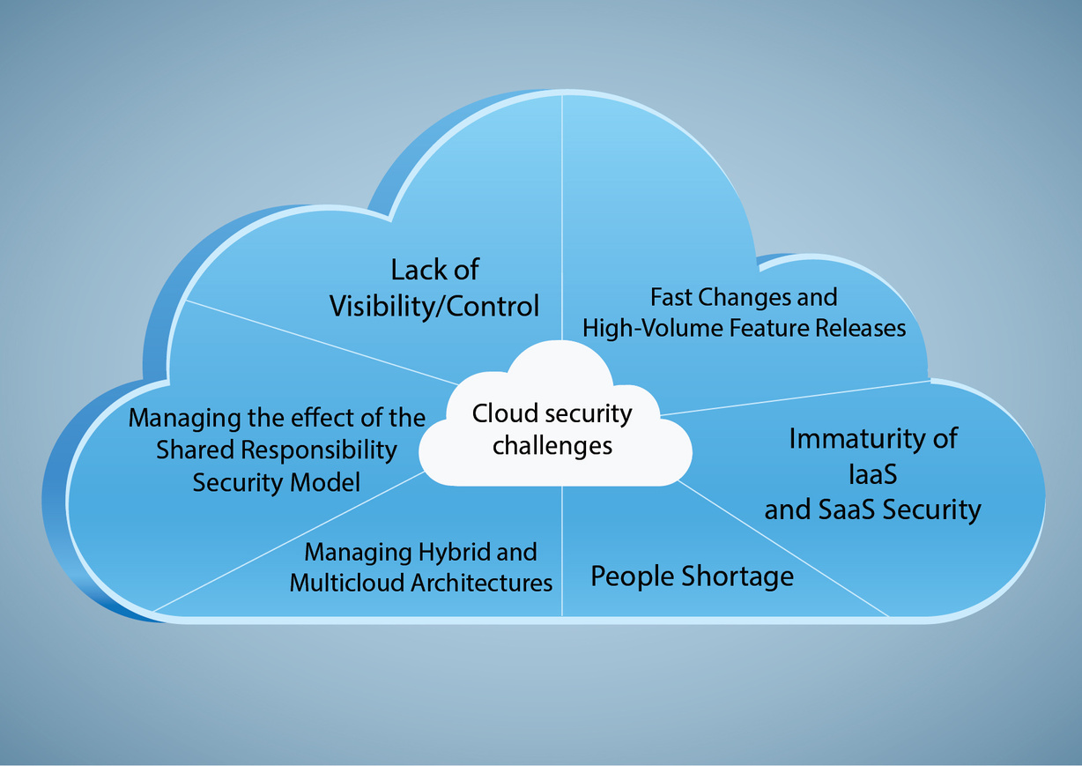
Introduction to Data Sharing Risks
Data sharing across organizations and cloud platforms is essential for collaboration and efficiency.
However, this practice introduces vulnerabilities that can be exploited by malicious actors.
Understanding these risks is crucial for implementing effective security measures.
Notes:
Image source: https://www.suntechnologies.com
2

Slide 3
Types of Data Shared in Cloud Environments
Common data shared include sensitive personal information, financial records, and intellectual property.
Public and private cloud platforms facilitate different levels of data sharing and access.
The nature of the data determines the level of security required during transmission and storage.
Notes:
Image source: https://www.suntechnologies.com
3

Slide 4
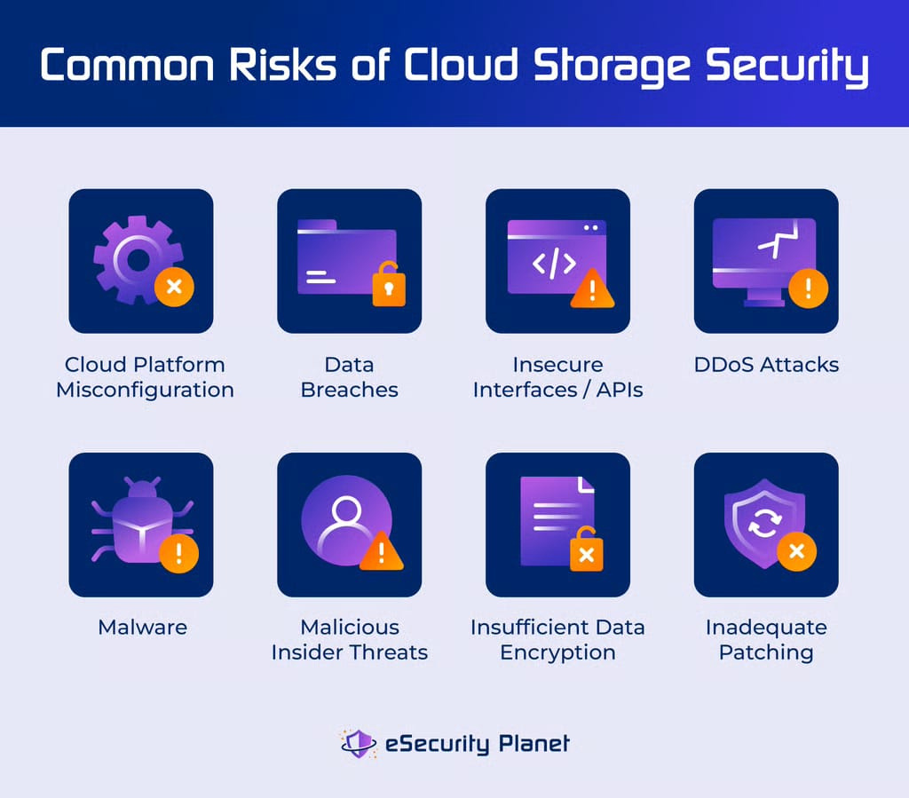

Common Interception Methods
Data can be intercepted through eavesdropping on network traffic, such as man-in-the-middle attacks.
Insecure Wi-Fi connections increase the risk of data being captured by unauthorized parties.
Attackers may also exploit vulnerabilities in cloud service APIs to access shared data.
Notes:
Image source: https://www.slidemake.com
4

Slide 5
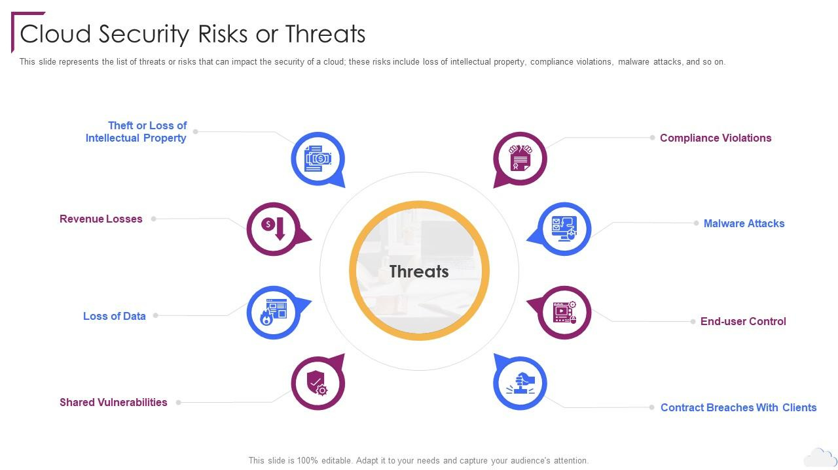
Risks of Data Misuse and Breach
Unauthorized access can lead to data theft, identity theft, and financial fraud.
Data breaches damage organizational reputation and can result in legal penalties.
Misuse of shared data by insiders or external hackers can compromise multiple organizations simultaneously.
Notes:
Image source: https://www.slidemake.com
5

Slide 6

Impact of Data Interception on Organizations
Interception can result in loss of confidential information and competitive advantage.
Organizations may face regulatory fines if data protection laws are violated.
Trust between organizations can be eroded, affecting future collaborations and partnerships.
Notes:
Image source: https://www.slidemake.com
6

Slide 7
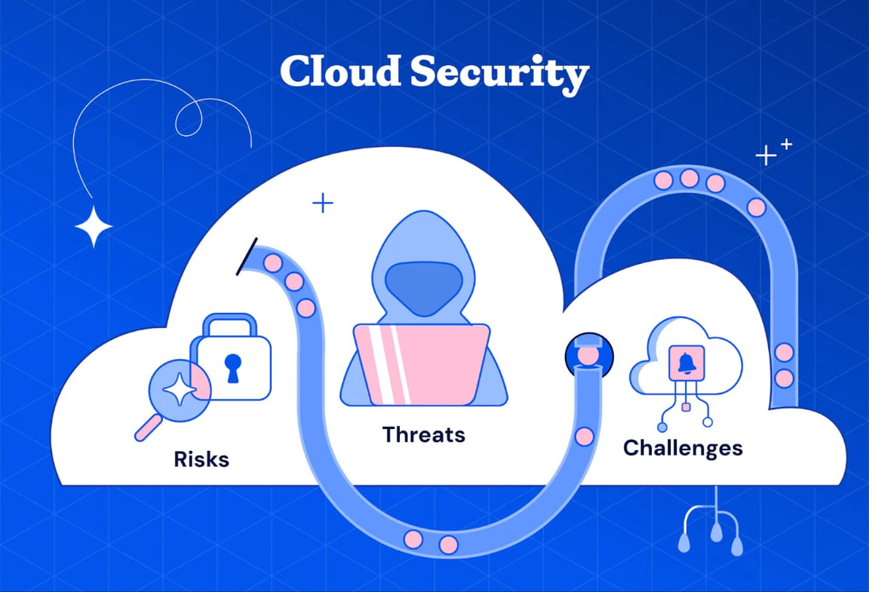
Vulnerabilities in Cloud Security
Cloud platforms may have security gaps due to misconfigurations or outdated software.
Shared environments increase the risk of cross-tenant data leakage.
Insufficient encryption during data transit and storage exposes data to interception.
Notes:
Image source: https://www.slidemake.com
7

Slide 8
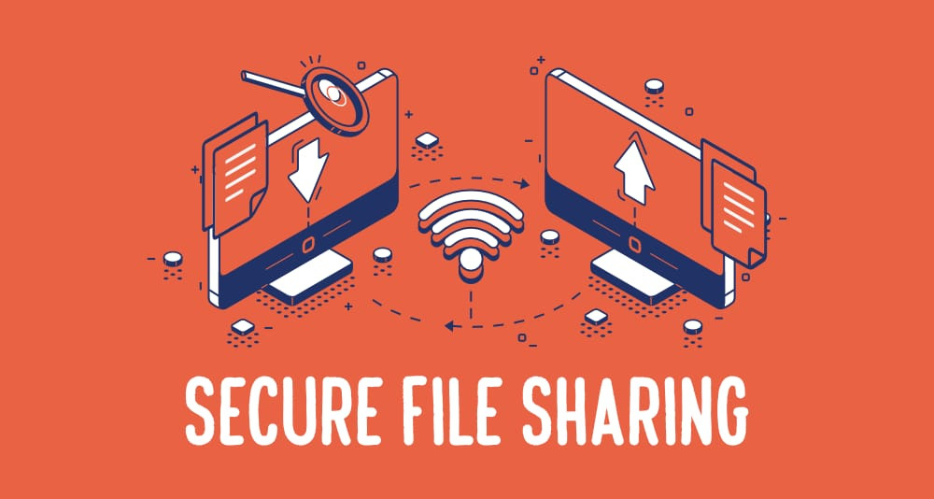
Best Practices for Securing Shared Data
Employ end-to-end encryption to protect data during transfer and storage.
Implement strict access controls and authentication mechanisms.
Regularly audit and update security protocols to address emerging threats.
Notes:
Image source: https://www.slidemake.com
8

Slide 9
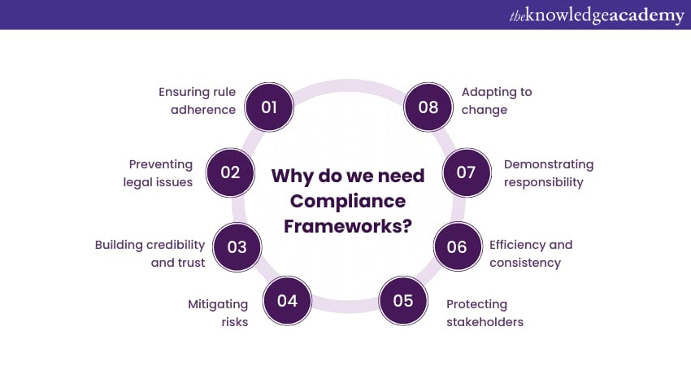
Role of Compliance and Legal Frameworks
Data protection laws like GDPR and HIPAA set standards for secure data sharing.
Organizations must ensure compliance to avoid legal penalties and protect user privacy.
Legal frameworks also mandate transparency and accountability in data handling practices.
Notes:
Image source: https://www.slidemake.com
9

Slide 10
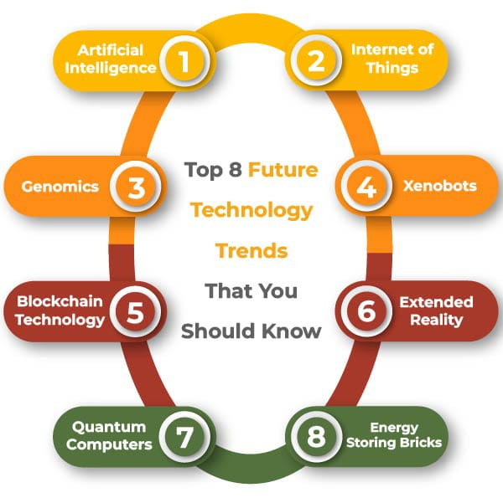
Future Trends and Technologies
Emerging technologies such as blockchain can enhance data integrity and security.
Artificial intelligence can help detect and respond to security threats in real-time.
Continued innovation is necessary to keep pace with evolving cyber threats related to data sharing.
Notes:
Image source: https://www.slidemake.com
10

Slide 11
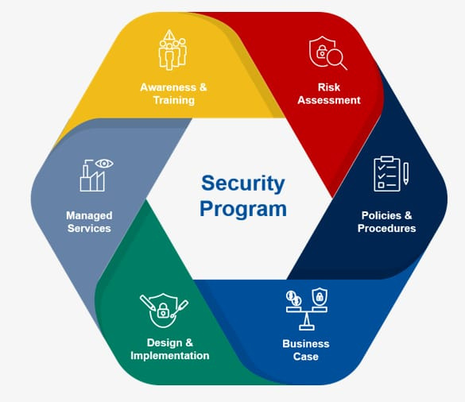
Conclusion
Sharing data across organizations offers significant benefits but also presents security challenges.
Implementing robust security measures is essential to prevent interception and misuse.
Organizations should stay informed about new threats and adopt best practices to safeguard shared data.
Notes:
Image source: https://www.slidemake.com
11

Slide 12


